Slide 1
Language models

Slide 2
Table of contents
Language modelling
Type of Language Models
N-grams
Neural LMs: RNN, CNN, Encoder-Decoder, Transformer
Transfer learning and Pretraing: ELMo, GPT, BERT

Slide 3
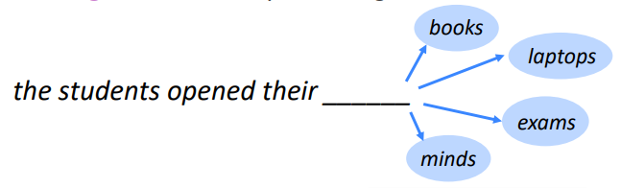
What is language modelling ?
Language Modelling is the task of predicting what word comes next.

Slide 4
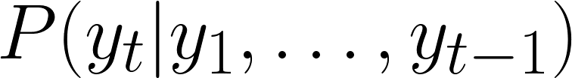
What is language modelling ?
Language Modelling is the task of predicting what word comes next.
A system that calculate this is called a Language Model.

Slide 5
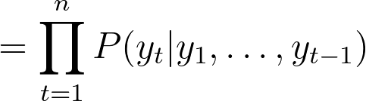
Language Models
Language Models (LMs) assign probability to a piece of text, i.e. How likely is a sentence to appear in a language ?

Slide 6
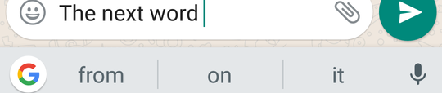
Language Models around us
Smartphones’ keyboard
Search engines
Translation services
Speech-to-text systems

Slide 7
Types of Language Model
N-grams
Neural LMs:
RNN
CNN
Transformer
=> Different ways to compute the conditional probabilities

Slide 8
N-gram Language Models
What: Compute ?
Solution: Estimate based on global statistics from a text corpora.
How: Count (refer to the last lecture)

Slide 9
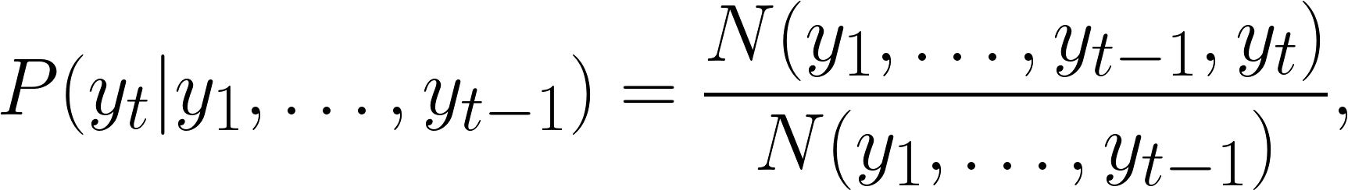
N-gram Language Models
The most naive way:
Problems:
To many possible fragments
Many fragments do not occur in the corpus
Notes:
Why are these problems ? What is the bigger one ? How to overcome them ?

Slide 10
N-gram Language Models
To many possible fragments
=> We make a Markov assumption:
The probability of a word only depends only on the preceding n-1 words.

Slide 11
N-gram Language Models
To many possible fragments
More formally, the n-gram model assumes that

Slide 12
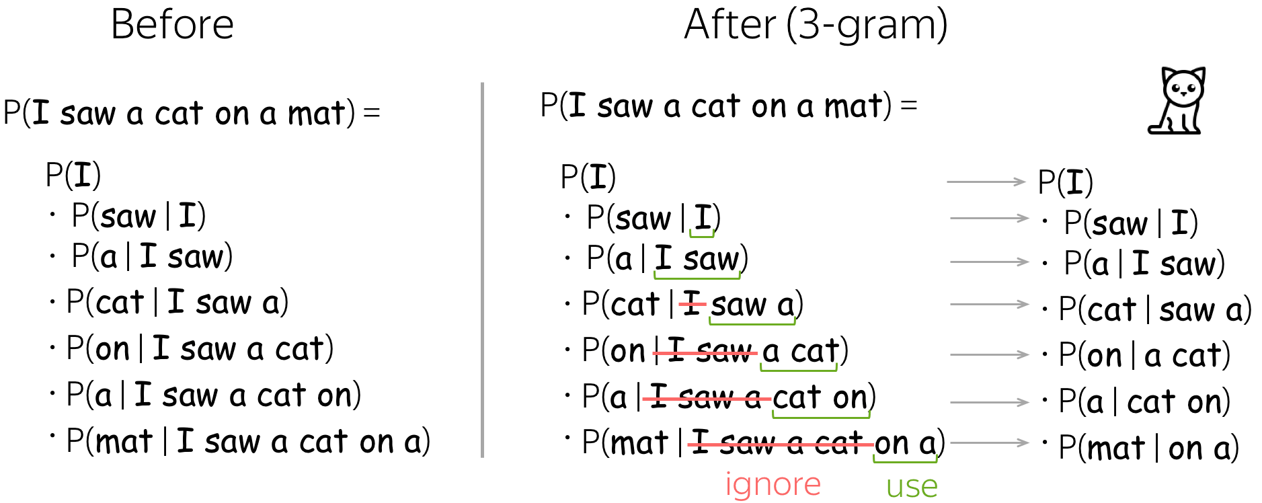
N-gram Language Models

Slide 13
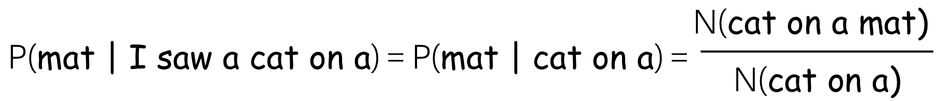
N-gram Language Models
Many fragments do not occur in the corpus
Consider the following example:

Slide 14
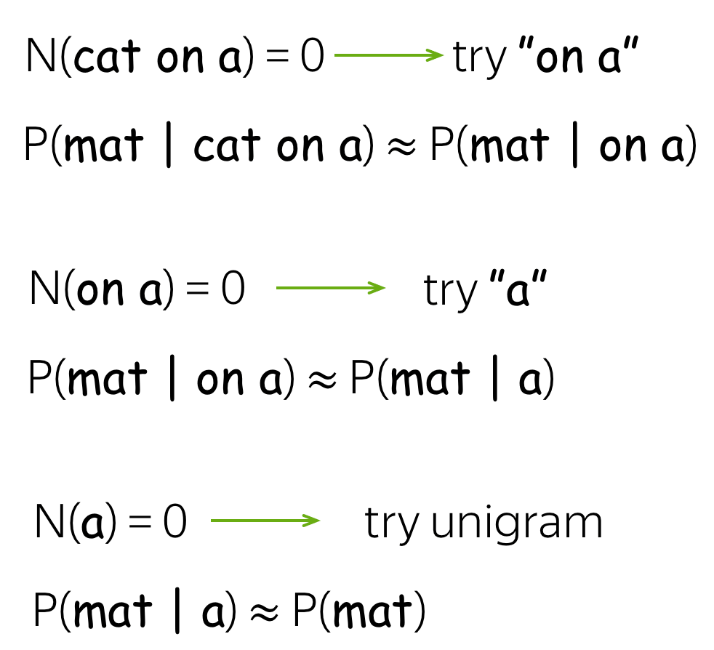
N-gram Language Models
Backoff: use less context for context we don't know much about.

Slide 15
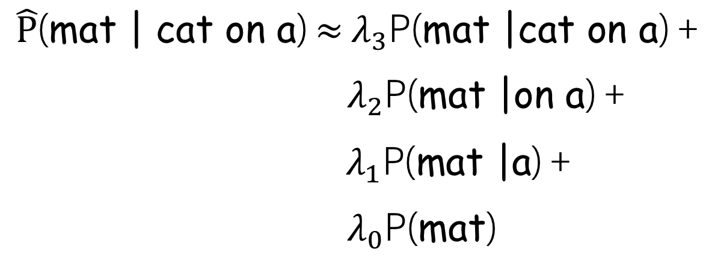
N-gram Language Models
Linear Interpolation: Weighted sum of all the lower grams

Slide 16
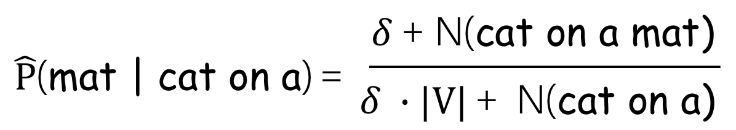
N-gram Language Models
Smoothing: Add a small number to all counts
Notes:
If delta = 1 => Laplace smoothing (add-one smoothing)
What is |V| and why multiply delta by it ?

Slide 17
Neural LMs
Recurrent
Convolutional
Conditional LMs
Attention Mechanism
Transformer
What: Compute ?
How: Train a neural network to predict them.

Slide 18
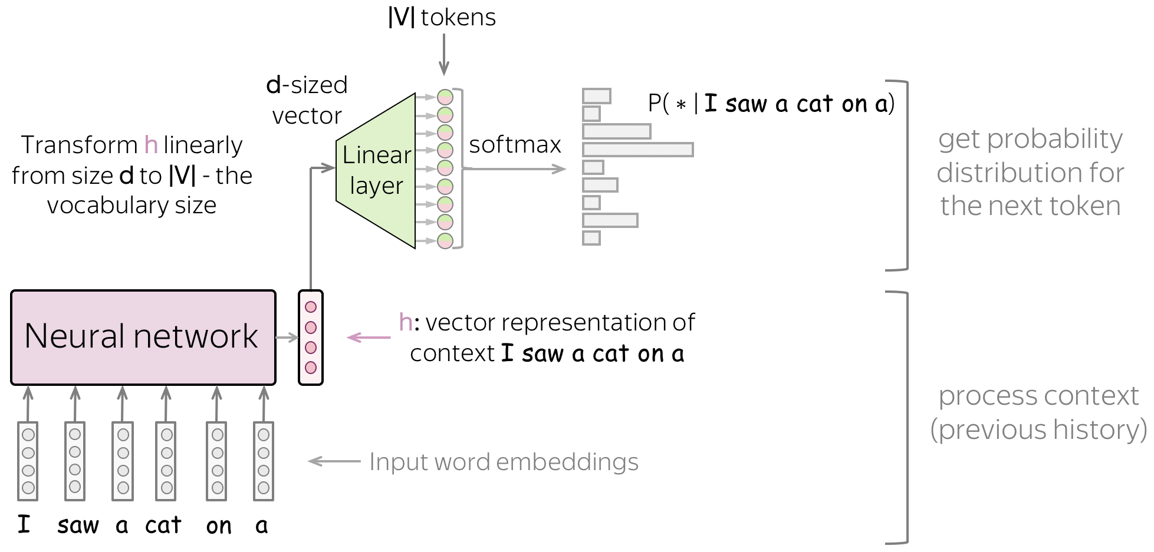
Neural LMs
General pipeline:
Notes:
feed word embeddings of the context into a network;
get vector representation of the context from the network;
from this vector representation, predict a probability distribution for the next token.

Slide 19
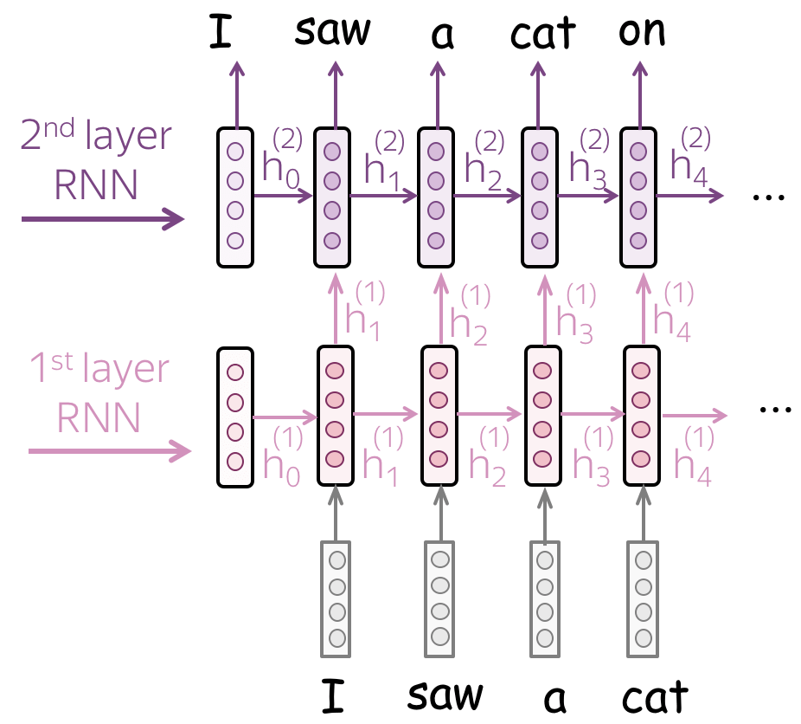
Recurrent LMs
At each step:
Update the current state contains information about previous context
Use it to predict the next token.
Advantage: Arbitrary long context
Problem: Losing long-range information (vanishing gradient) => LSTM, GRU

Slide 20
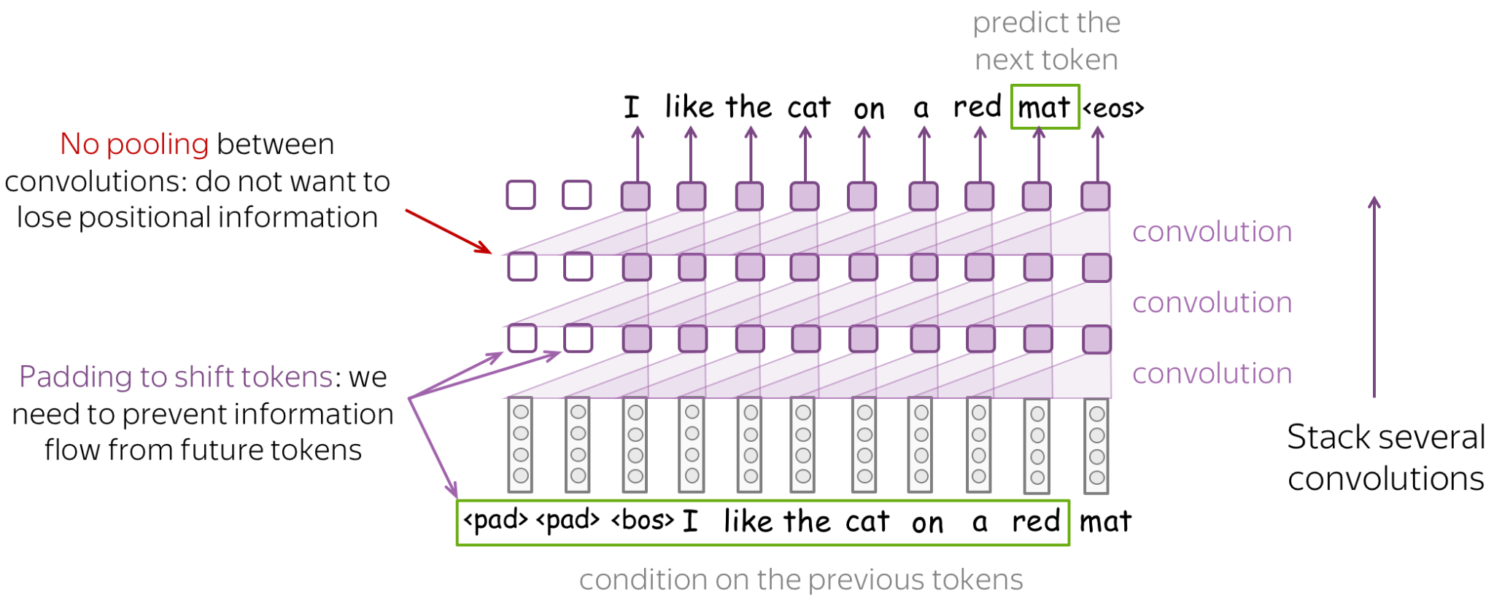
Convolutional LMs

Slide 21
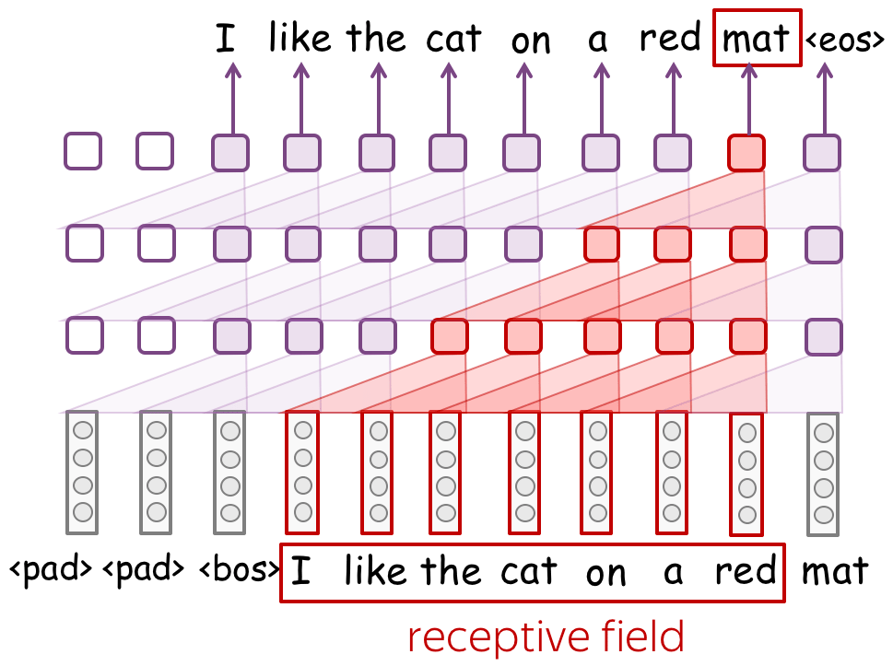
Convolutional LMs
Problem: Fixed-sized context - what we don’t like in n-gram models.
=> with stacked convolutional layers, the context can be quite long.

Slide 22
Conditional LMs
Many NLP problems can be formulated as a sequence-to-sequence task:
Machine translation
Text generation
Speech recognition
OCR

Slide 23
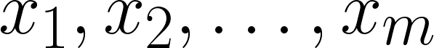
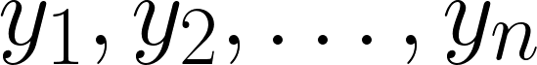
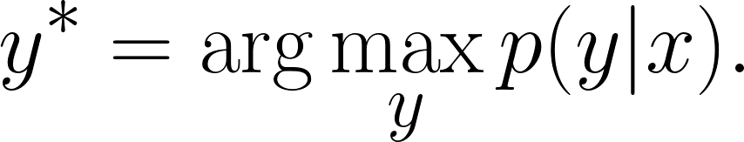
Conditional LMs
Seq2seq:
Given the input sequence
Find the output sequence that maximizes the conditional probability:
Note that the lengths can be different

Slide 24

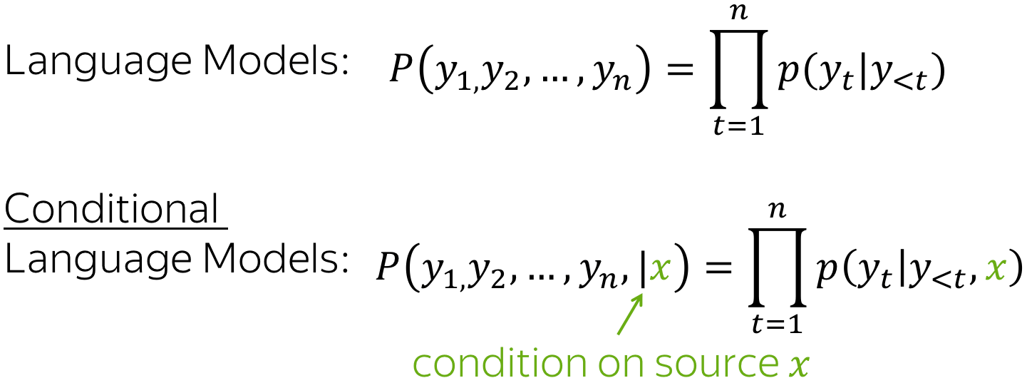
Conditional LMs
The Seq2seq task can using Conditional Language Models, which operate similarly to LMs but additionally receive source information

Slide 25
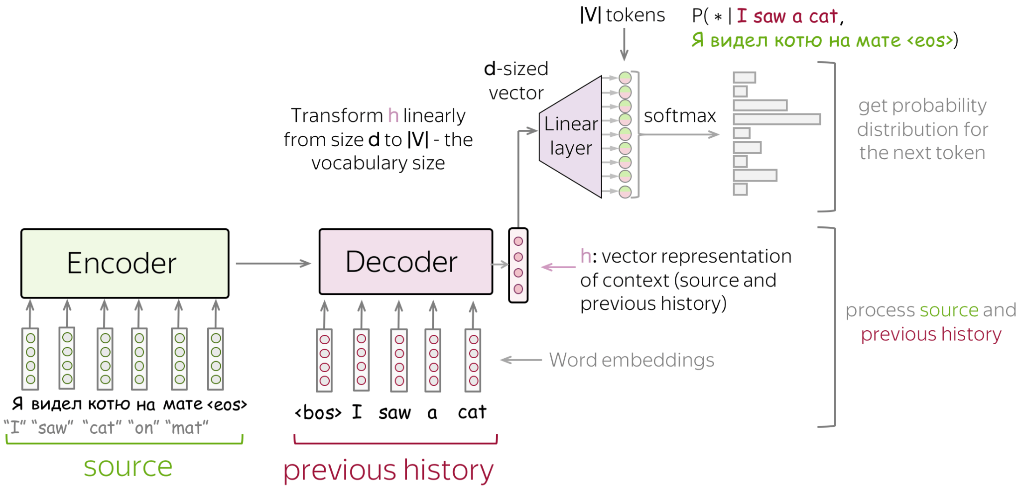
The Encoder-Decoder framework
Notes:
The UNet architecture also use this framework
encoder - reads source sequence and produces its representation;
decoder - uses source representation from the encoder to generate the target sequence.

Slide 26
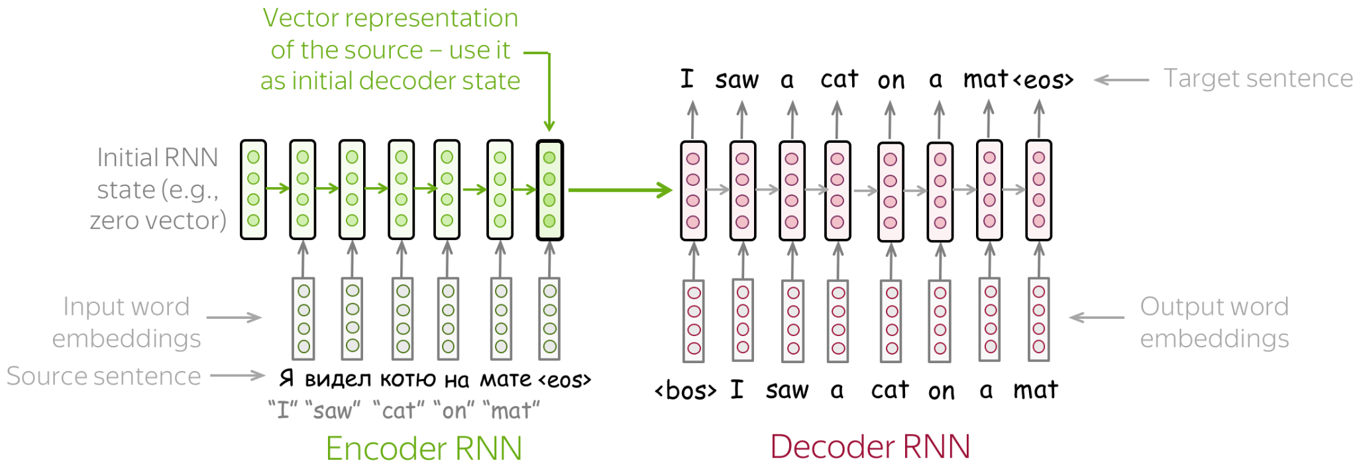
The Encoder-Decoder framework
A simple Encoder-Decoder model
Notes:
What could be the problem ?

Slide 27
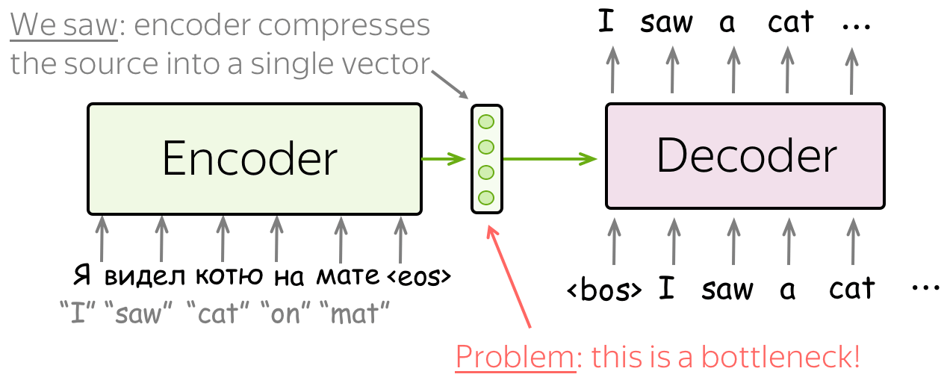
The Attention Mechanism
Problems of fixed encoder representation:
Notes:
For the encoder: hard to compress the sentence into 1 vector
For the decoder: different steps need different information from the source

Slide 28
The Attention Mechanism
Idea
At decoder steps, let a model “attend” to different parts of the input.
=> no need for a single representation of the input.
Original paper: Neural Machine Translation by Jointly Learning to Align and Translate

Slide 29
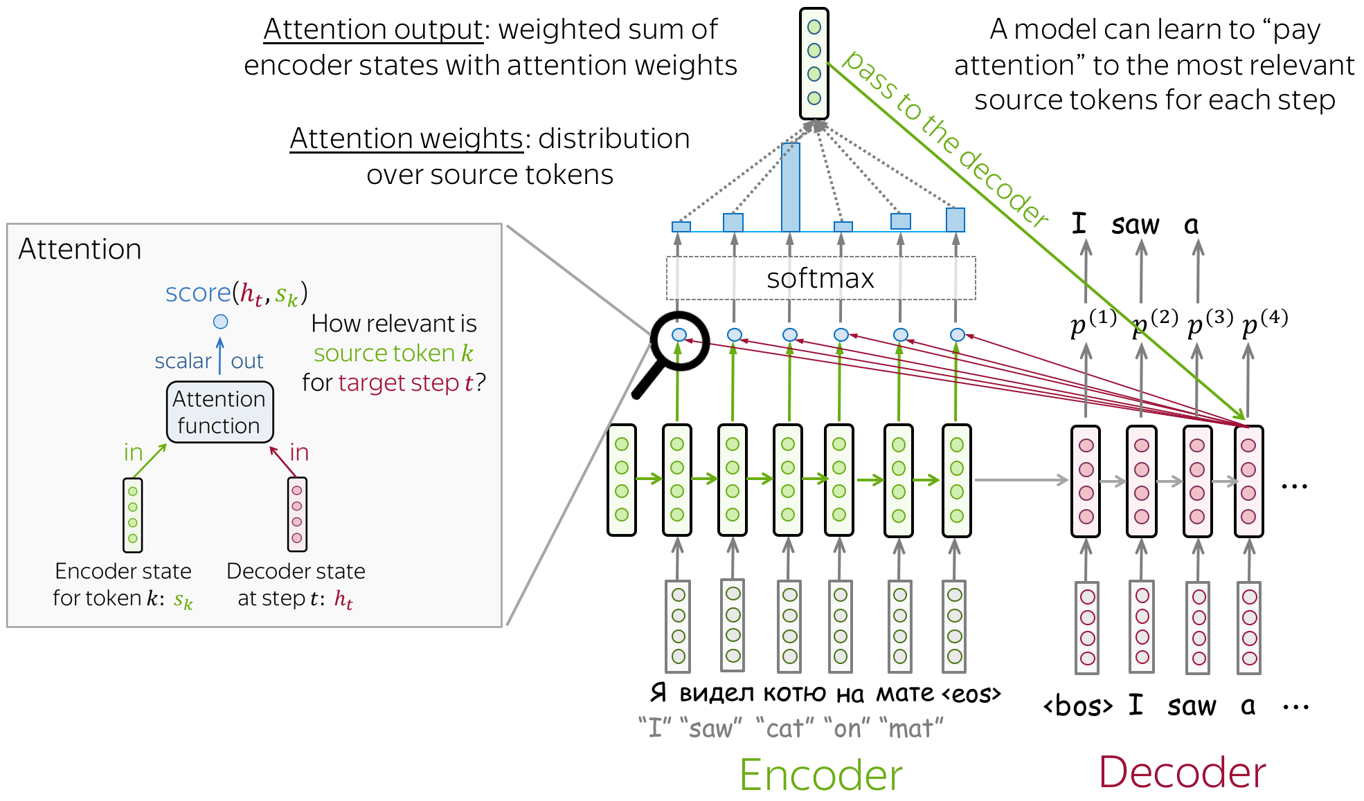
The Attention Mechanism
Notes:
Thought exercise: How to make LSTM better remembering the early source tokens without attention.
https://arxiv.org/pdf/1409.3215.pdf

Slide 30
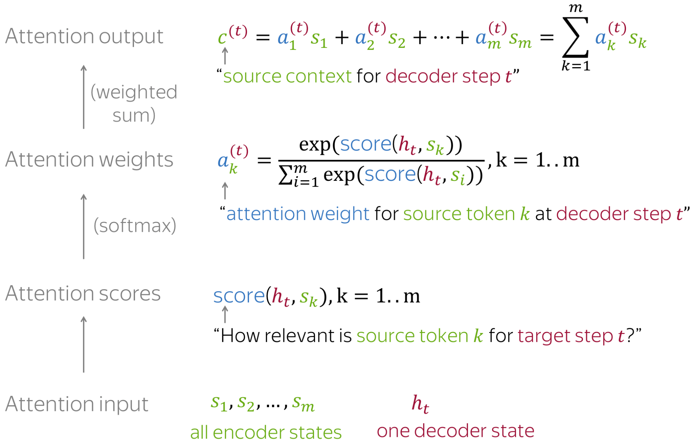
The Attention Mechanism
Notes:
At each decoder step, attention
receives attention input: a decoder state h_t and all encoder states s_1, s_2, …, s_m
computes attention scores
For each encoder state s_k, attention computes its "relevance" for this decoder state h_t. Formally, it applies an attention function which receives one decoder state and one encoder state and returns a scalar value score(h_t, s_k)
computes attention weights: a probability distribution - softmax applied to attention scores
computes attention output: the weighted sum of encoder states with attention weights.

Slide 31
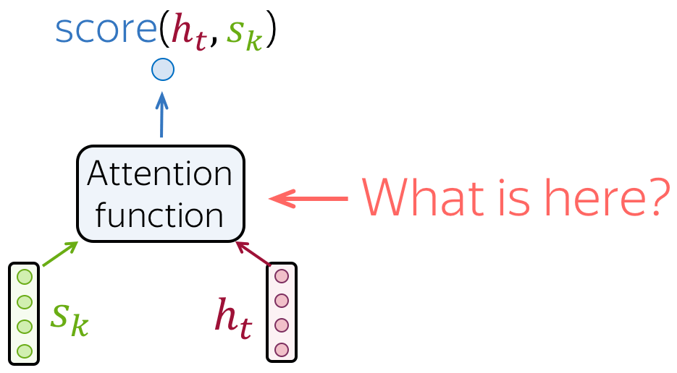
The Attention Mechanism
How to compute the Attention Score ?

Slide 32
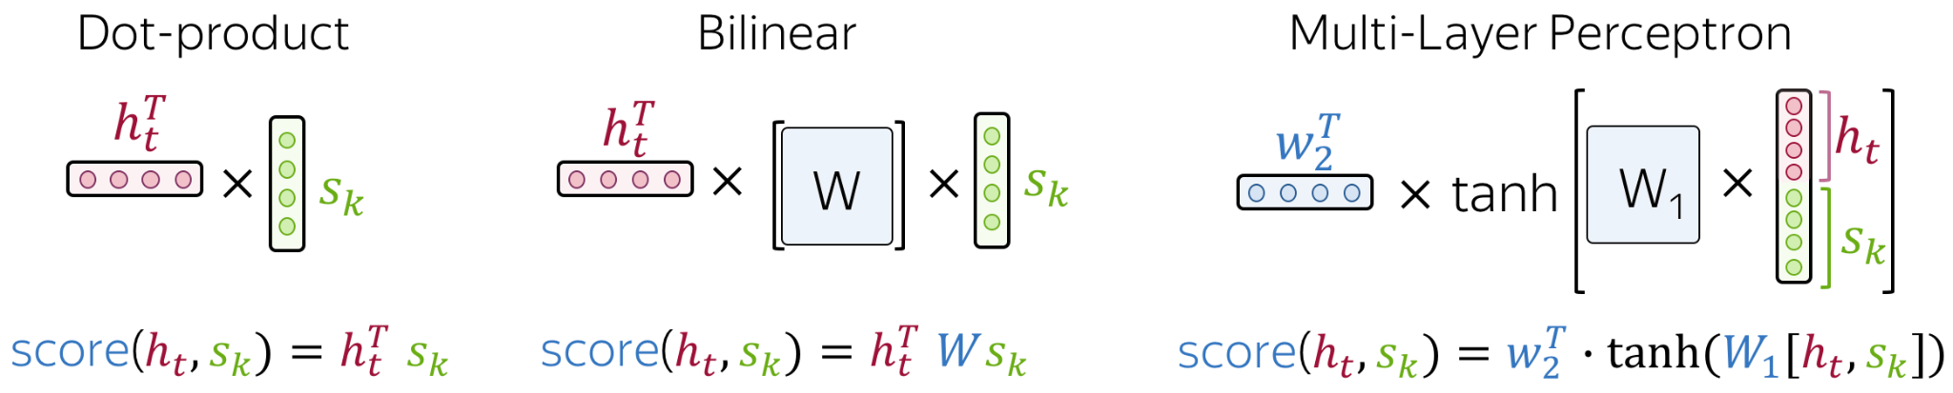
The Attention Mechanism
Most popular ones:
the simplest way
a.k.a Luong Attention
a.k.a Bahdanau attention
Notes:
Thought exercise: How to make LSTM better remembering the early source tokens without attention.

Slide 33
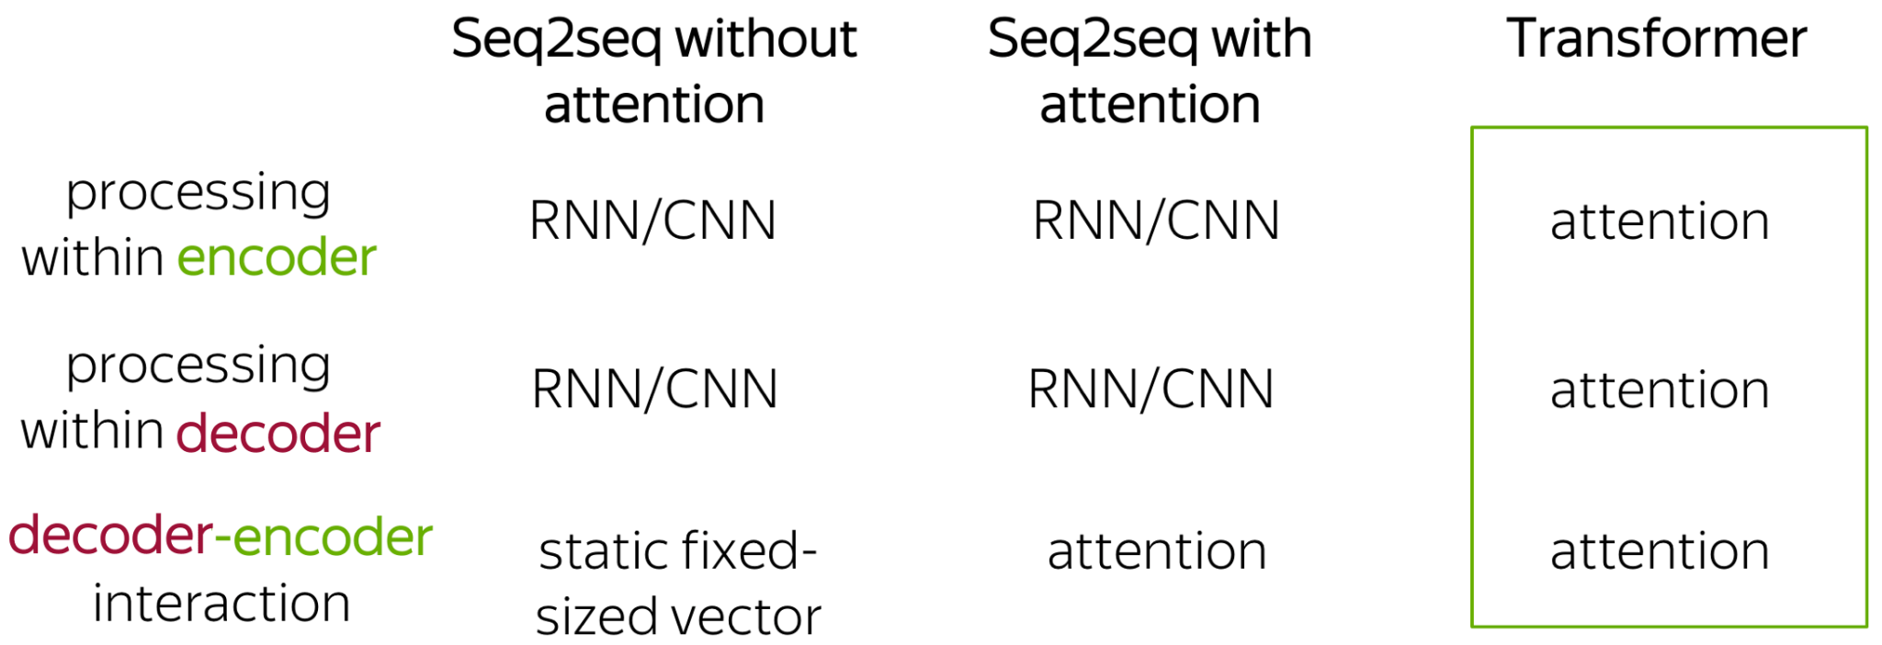
Transformer
Originally introduced in the paper Attention is All You Need

Slide 34

Transformer
Encoder: all source tokens
Look at each other
Update their representations
Repeat N times.
Decoder: target token at each step
Looks at previous target representations
Looks at source representations
Update its representation
Repeat M times.
The animation is from the Google AI blog post.
Notes:
Why does this can be more suitable than RNNs for language understanding ?

Slide 35
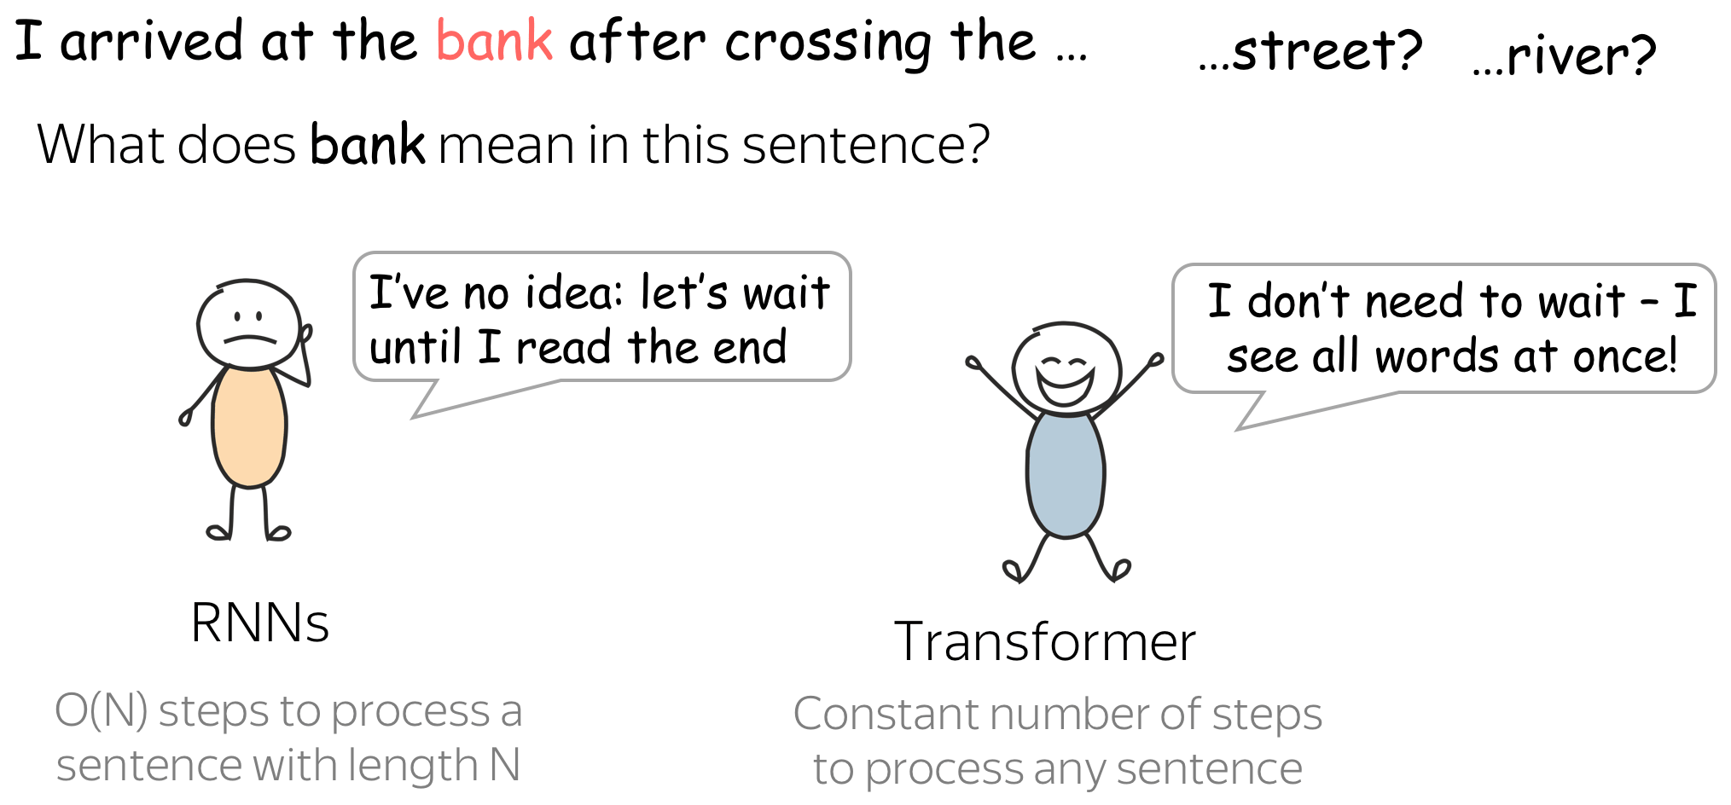
Transformer

Slide 36
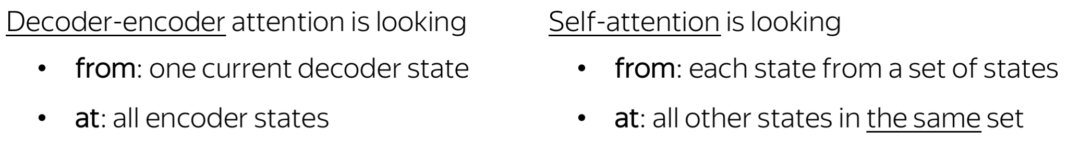
Transformer
In Transformer, the sequence attends to itself to derive context-aware representations.
=> hence the name Self-Attention

Slide 37
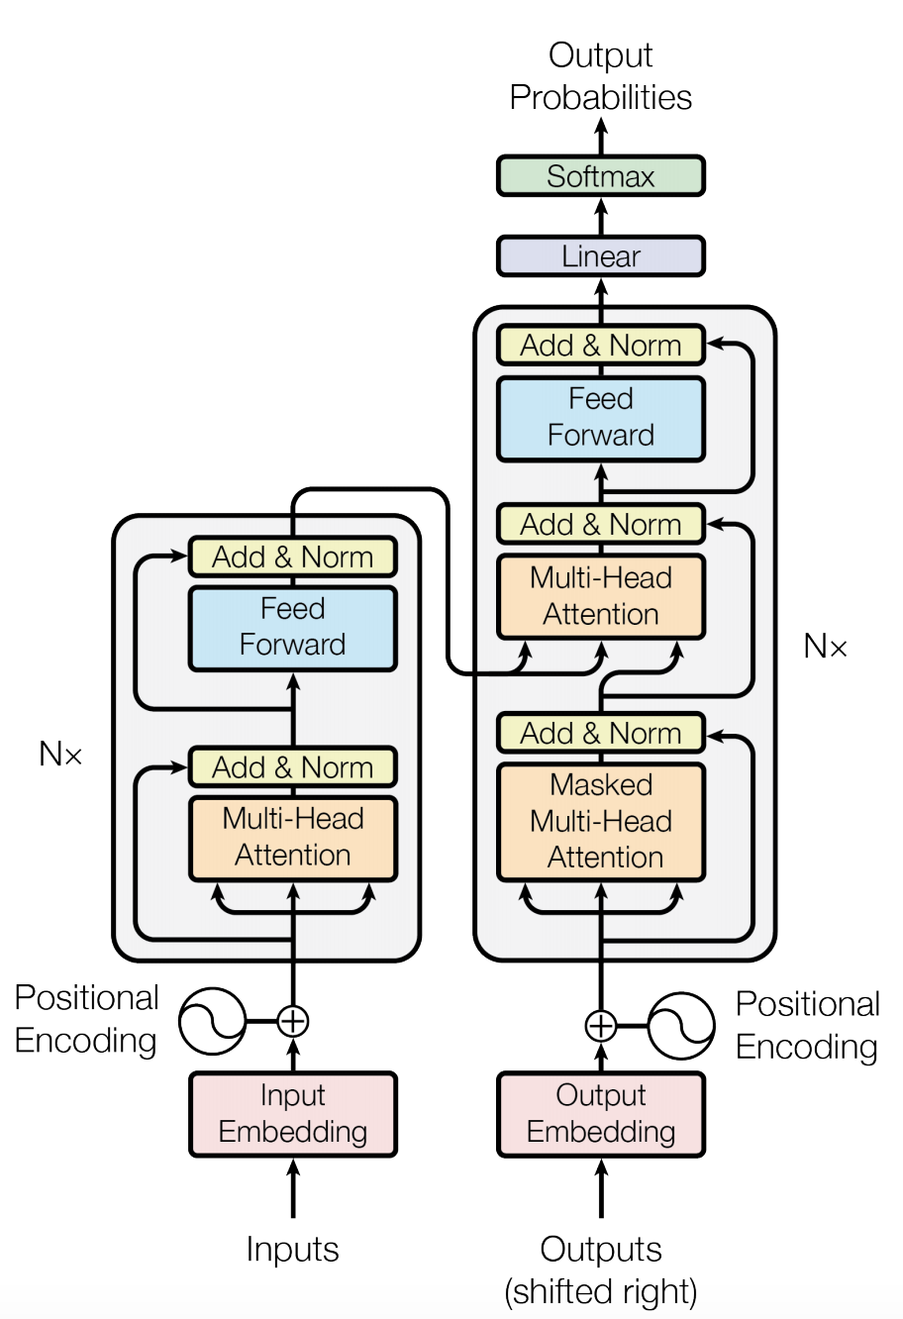
Transformer
Architecture
Don’t worry, we will go through each block. By the end, you will be able to implement the whole architecture.

Slide 38
Multi-head Attention
look at other tokens and gather information
Notes:
Why masked attention in the decoder ?

Slide 39
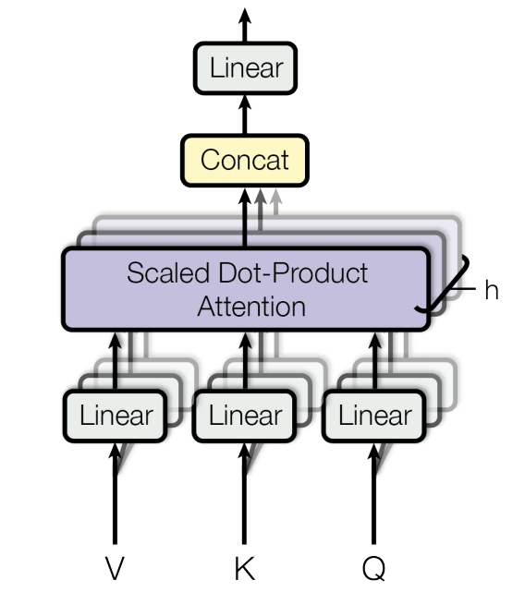
Multi-head Attention
look at other tokens and gather information

Slide 40
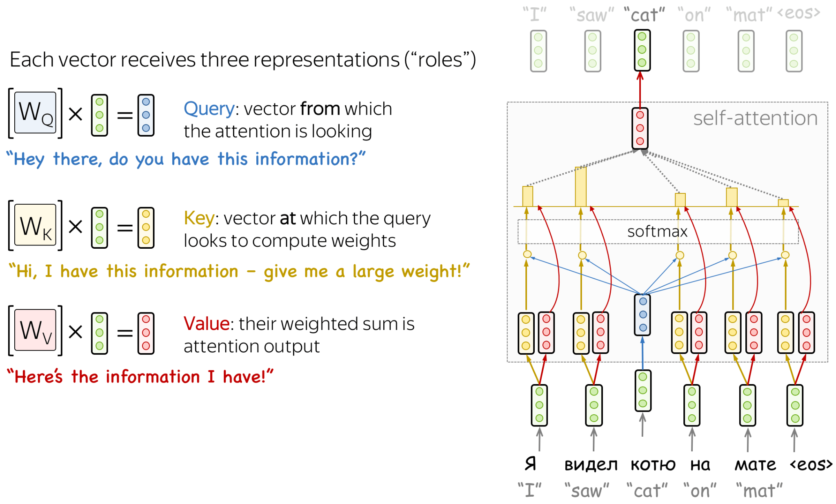
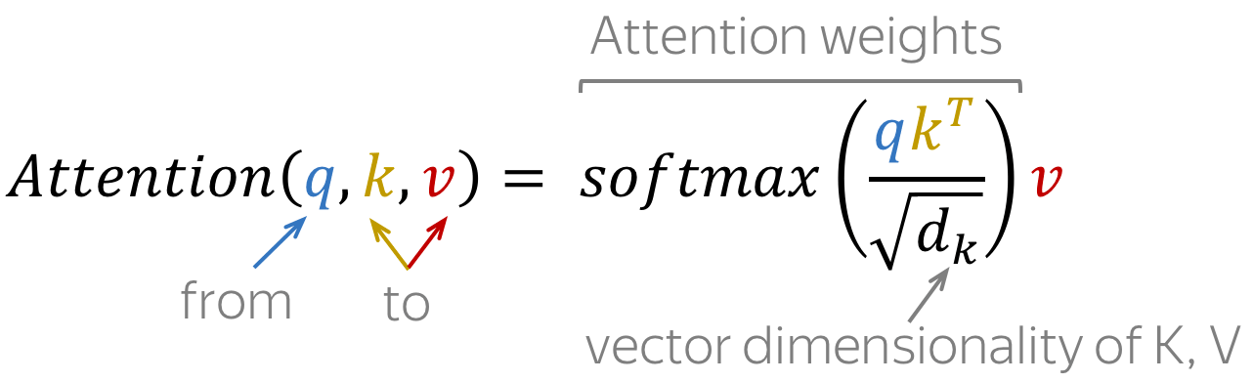
Self-Attention
Notes:
Each input token in self-attention receives three representations corresponding to the roles it can play:
query - asking for information;
key - saying that it has some information;
value - giving the information.
The query is used when a token looks at others - it's seeking the information to understand itself better. The key is responding to a query's request: it is used to compute attention weights. The value is used to compute attention output: it gives information to the tokens which "say" they need it (i.e. assigned large weights to this token).

Slide 41
Self-Attention
Hands-on: Finish part 1
https://colab.research.google.com/drive/1v1kAciuqsrmxedL3lETHUZBDPTk28Jj7?usp=sharing

Slide 42
Multi-head Attention
look at other tokens and gather information

Slide 43
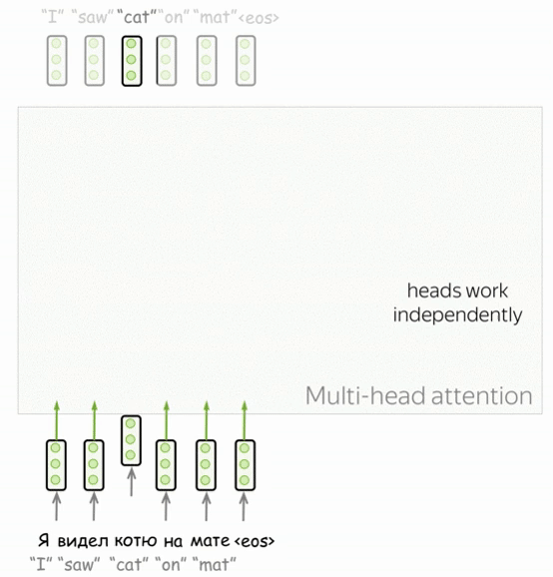
Multi-head Attention
Motivation: each word can be a part of many relations
Several “heads” work independently allows the model to focus on different things

Slide 44
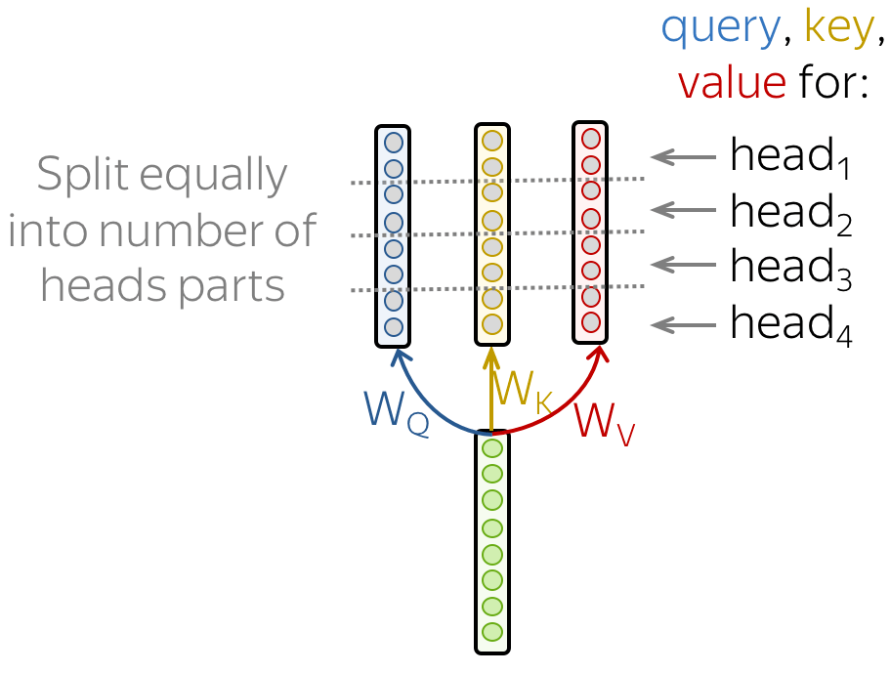
Multi-head Attention
In implementation, the q, k and v are splitted into several parts => the output dimensions remain the same

Slide 45
Multi-head Attention
Hands-on: Finish part 2
https://colab.research.google.com/drive/1v1kAciuqsrmxedL3lETHUZBDPTk28Jj7?usp=sharing

Slide 46
Feed Forward, Add & Norm
take a moment to think and process the information

Slide 47
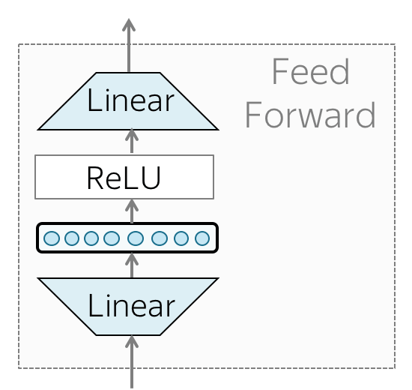
Feed Forward, Add & Norm

Slide 48
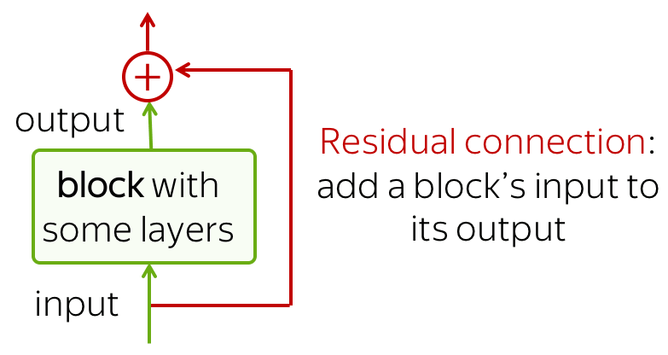
Feed Forward, Add & Norm
Residual connections

Slide 49
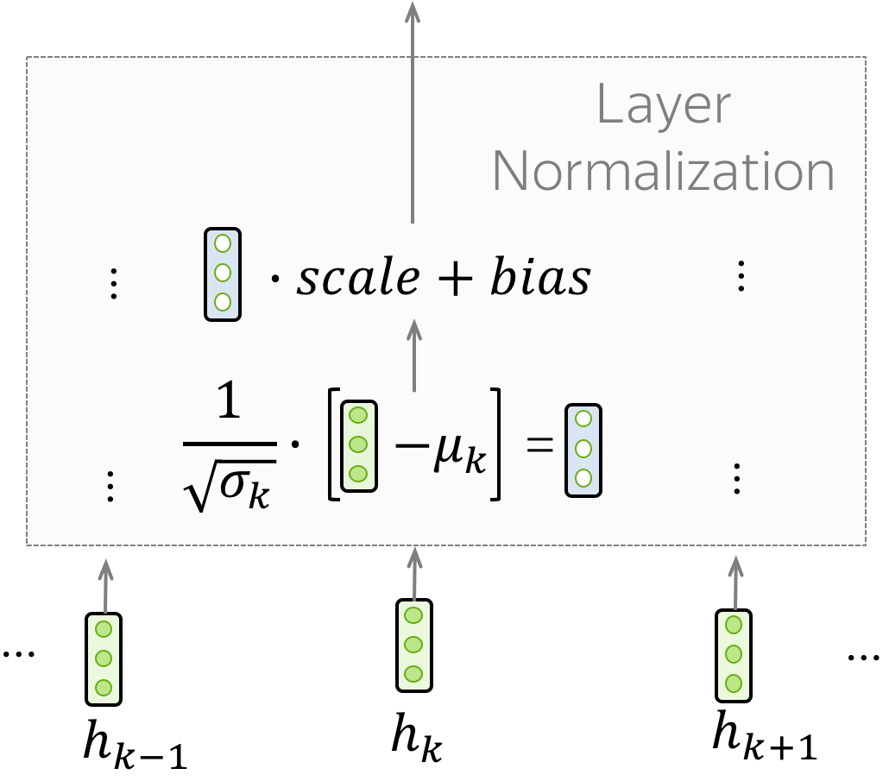
Feed Forward, Add & Norm
Layer Normalization
independently normalizes vector representation of each example in batch
scale and bias are trainable, which are used after normalization to recale layer's outputs.
μ_k and σ_k are evaluated for each example, but scale and bias are the same - these are layer parameters.

Slide 50
Multi-head Attention
Hands-on: Finish part 3
https://colab.research.google.com/drive/1v1kAciuqsrmxedL3lETHUZBDPTk28Jj7?usp=sharing

Slide 51
Positional Embedding
The Transformer does not know the order of input tokens
Notes:
Why ?

Slide 52
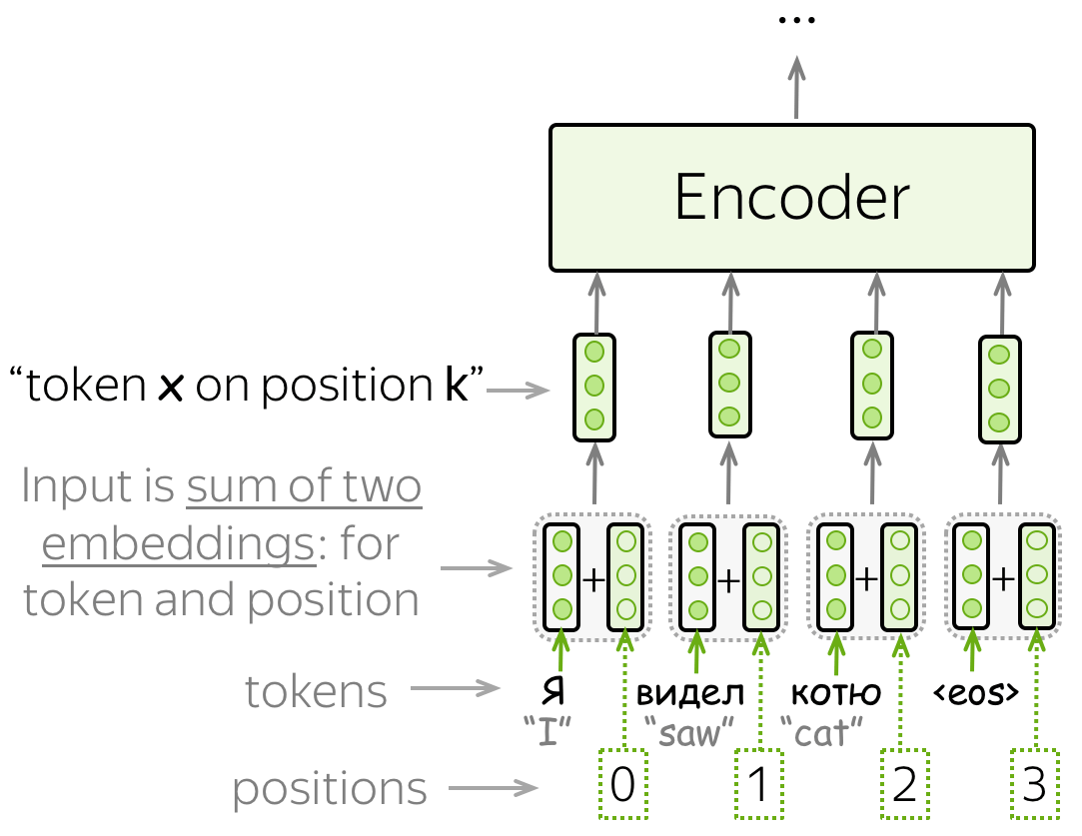
Positional Embedding
The positional embeddings can be learned, but the authors found that having fixed ones does not hurt the quality.

Slide 53
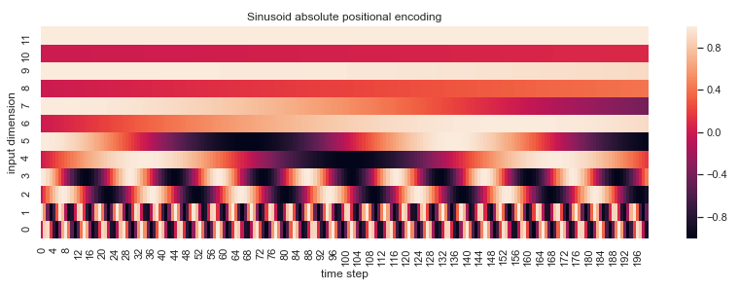
Positional Embedding
Why sinusoid functions ?
PEpos+k can be represented as a linear function of PEpos => allow the model to easily learn to attend by relative position
The distance between neighboring time-steps are symmetrical and decays nicely with time. => far apart tokens have weaker relations.
Notes:
Similar idea to binary numbers
Why both sine and cosine ?
Why not zero and one ?

Slide 54
Positional Attention
Hands-on: Finish part 4 and 5
https://colab.research.google.com/drive/1v1kAciuqsrmxedL3lETHUZBDPTk28Jj7?usp=sharing

Slide 55
Masked Multi-head Attention
"Don't Look Ahead" for the Decoder
Notes:
Why masked attention in the decoder ?

Slide 56
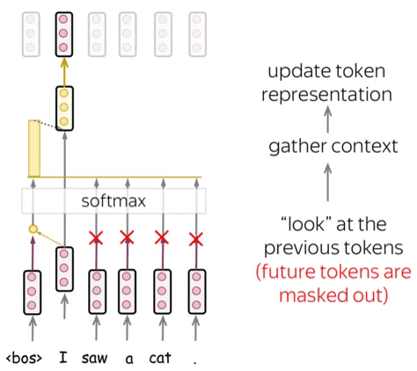
Masked Self-Attention
The decoder generates one token at a time => during generation, it does not know future tokens.

Slide 57
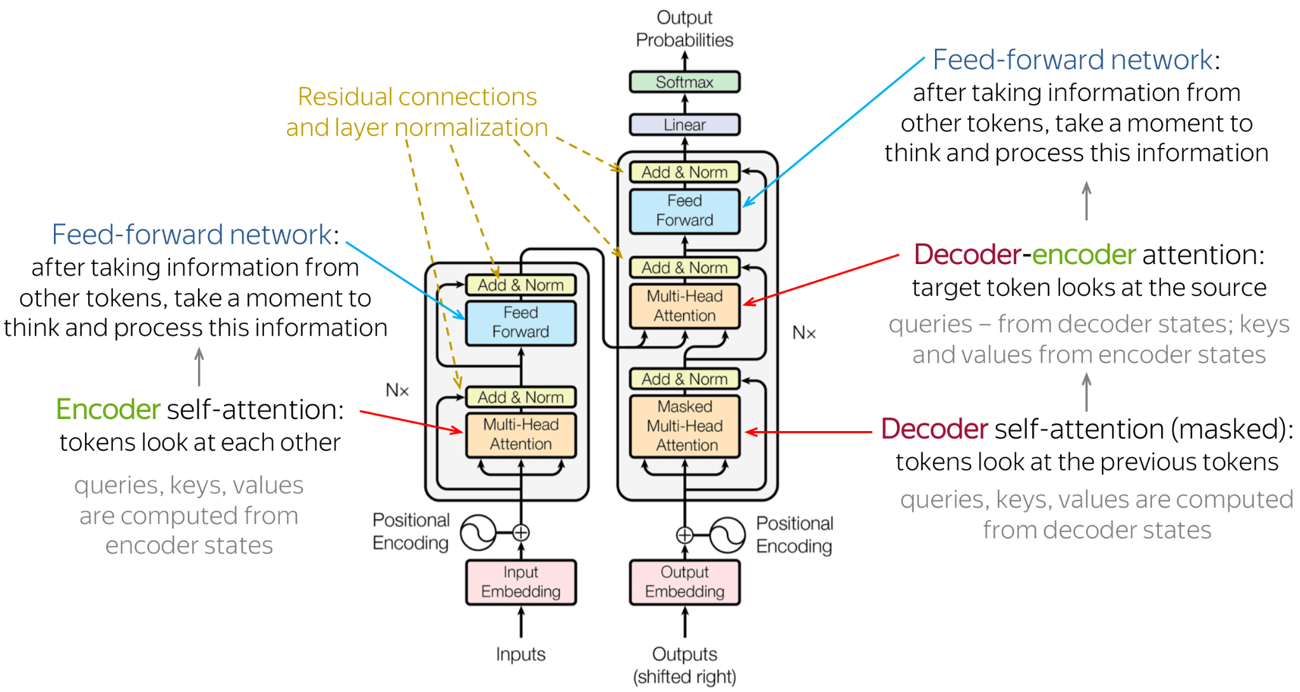
Transformer Summary

Slide 58
Transformer Summary
Hands-on: Finish part 6
https://colab.research.google.com/drive/1v1kAciuqsrmxedL3lETHUZBDPTk28Jj7?usp=sharing

Slide 59
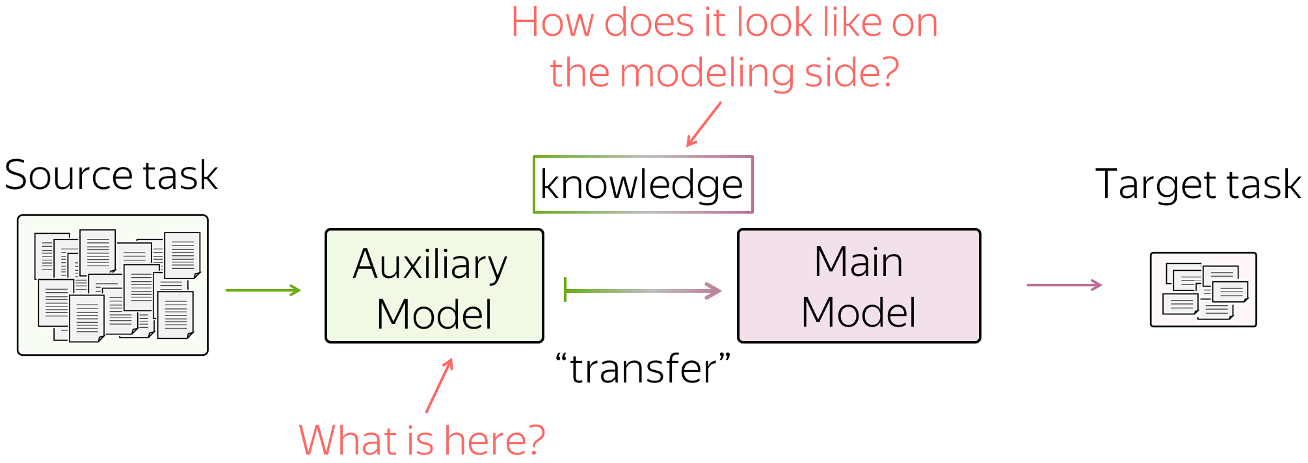
Transfer learning

Slide 60
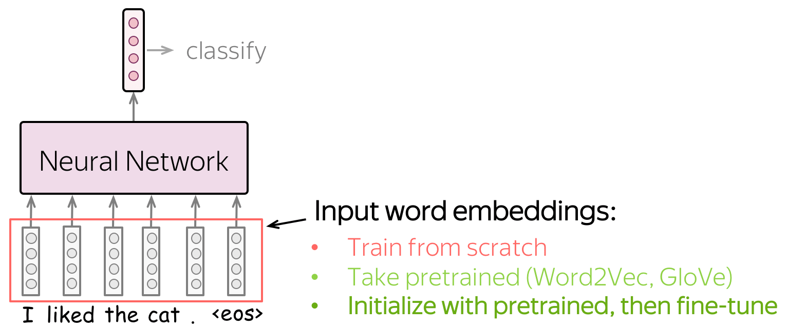
Transfer learning
The Simplest Transfer: Word Embeddings

Slide 61
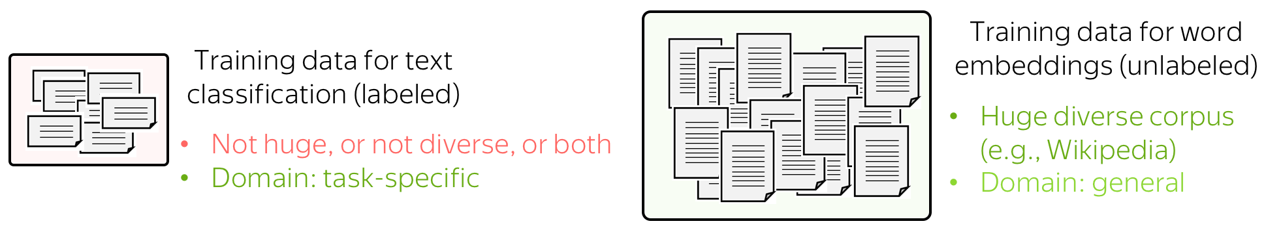
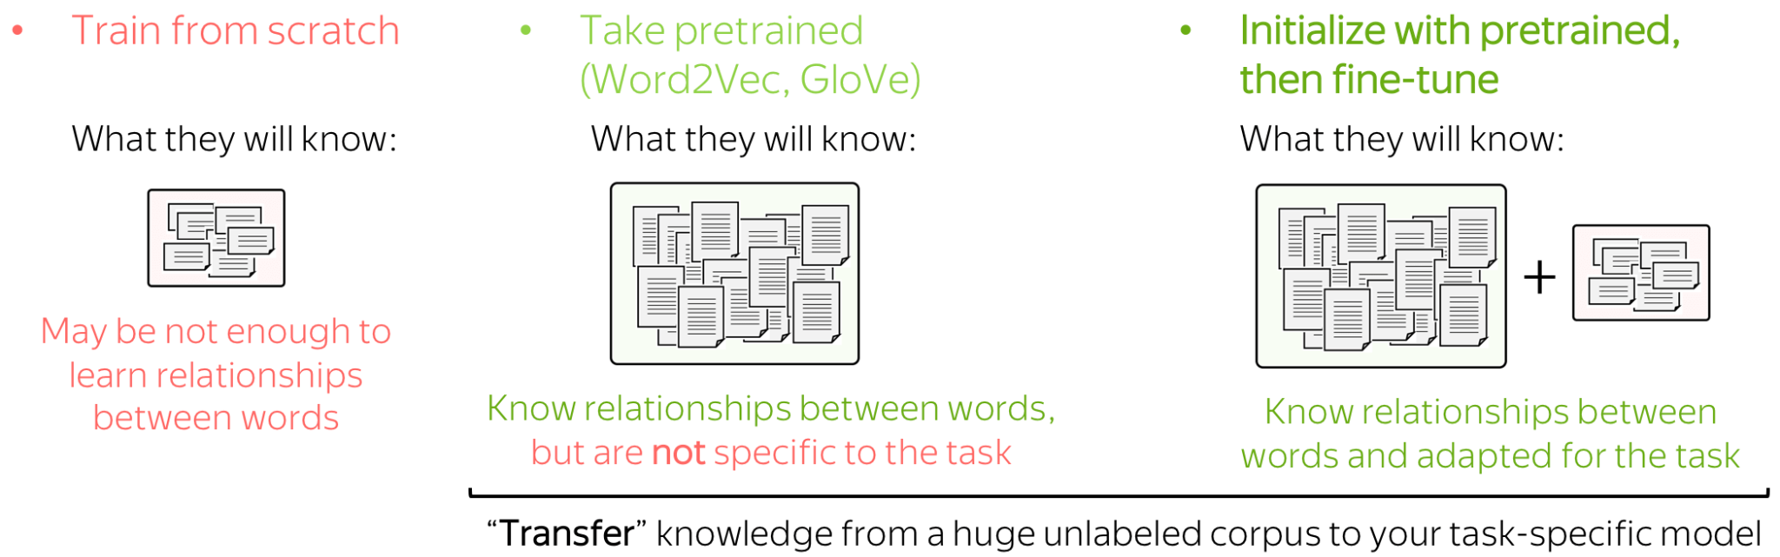
Transfer learning

Slide 62
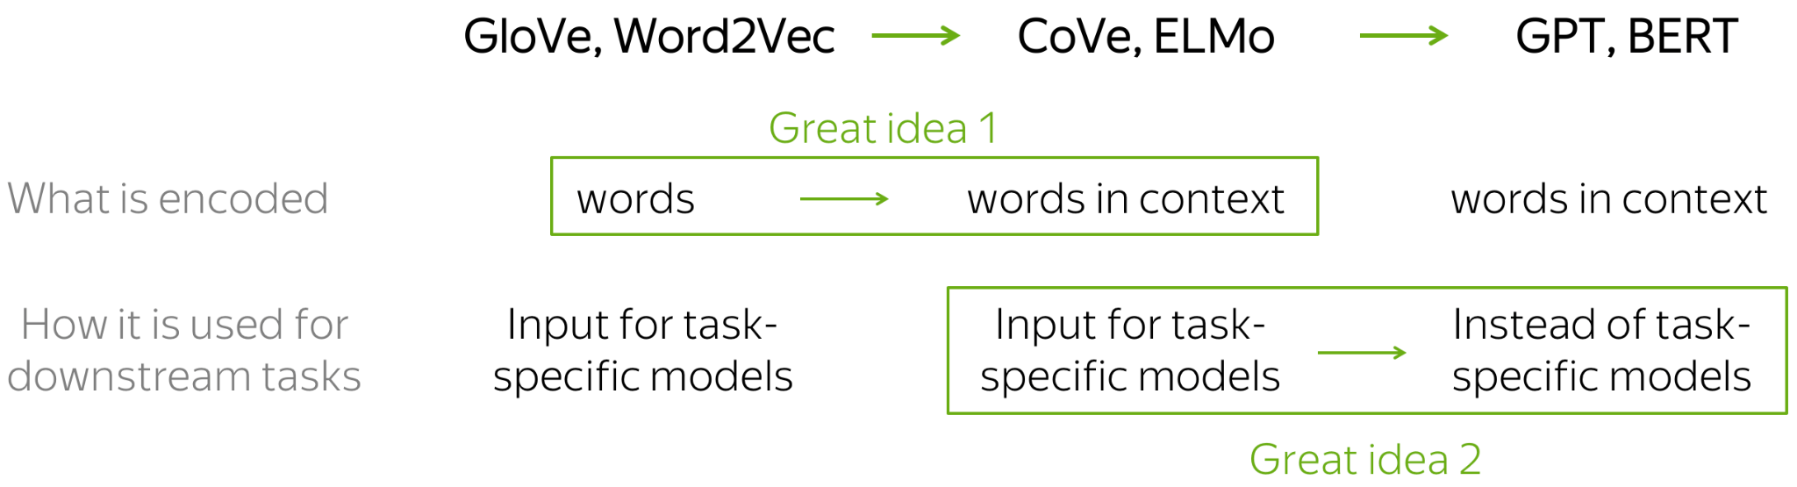
Pretrained Models
Roughly speaking, the transition from word embeddings to the current state-of-the-art models can be explained with just two ideas.
Notes:
The two great ideas:
what is encoded: from words to words-in-context (the transition from Word2Vec/GloVe/etc. to Cove/ELMo);
usage for downstream tasks: from replacing only word embeddings in task-specific models to replacing entire task-specific models (the transition from Cove/ELMo to GPT/BERT)

Slide 63
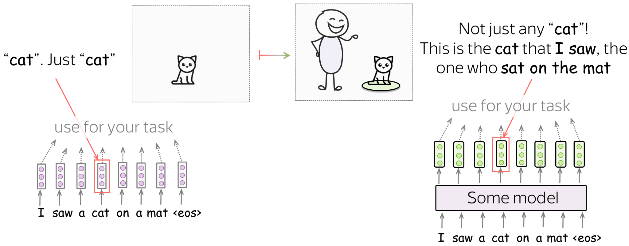
Idea 1: From Words to Words-in-Context
Instead of representing individual words, we can learn to represent words along with the context they are used in.
Notes:
By training a language model we get much more than by training word embeddings: language models process not just individual words, but sentences/paragraphs/etc. Inside a model, LMs too build vector representations for each word, but these vectors represent not just words, but words in context.
Like from unigram to n-gram

Slide 64
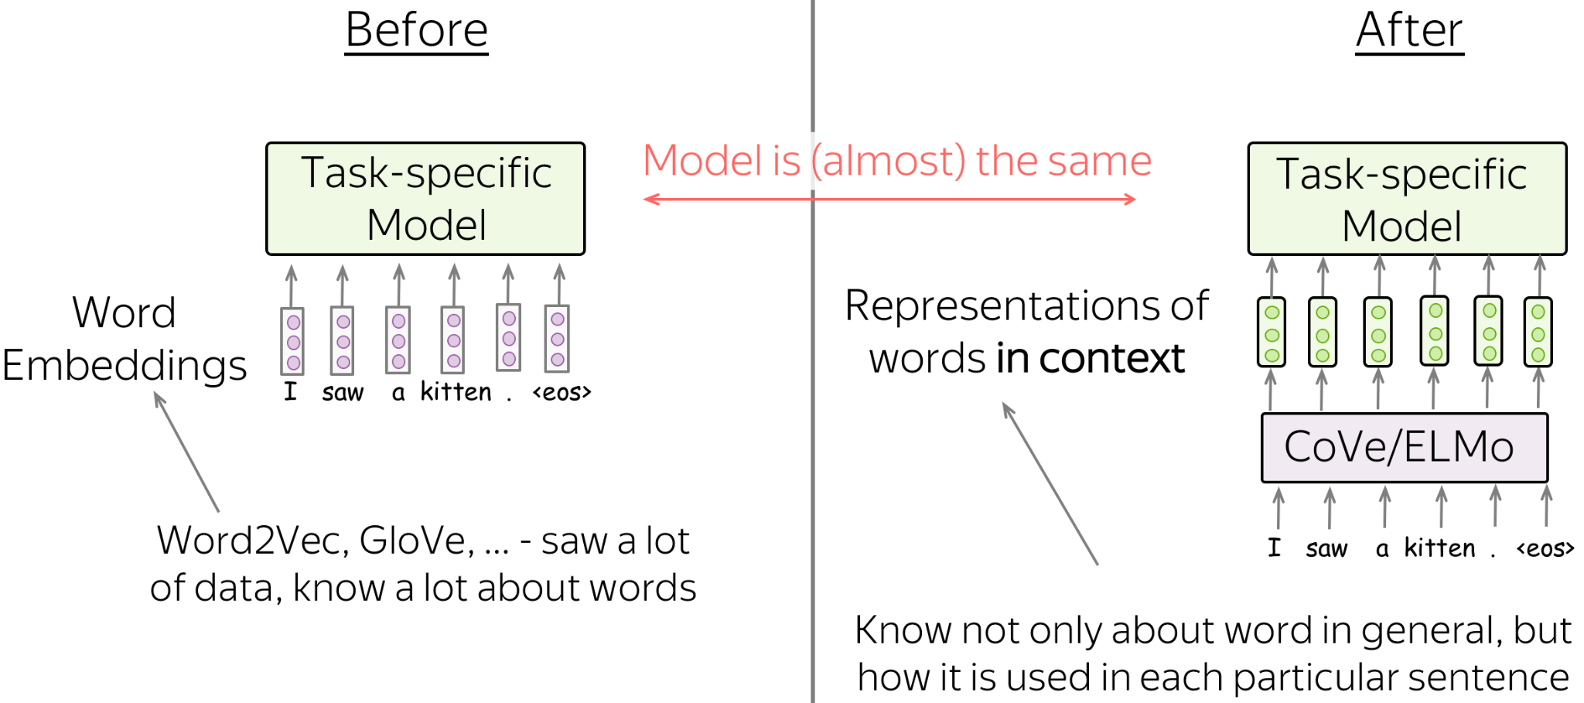
Idea 1: From Words to Words-in-Context
Transfer: Put Representations Instead of Word Embeddings
Notes:
The way their representations are used for downstream tasks is almost the same as with word embeddings: usually, you just have to put representations instead of word embeddings. That's it!

Slide 65
ELMo
ELMo: Embeddings from Language Models
Introduced in: Deep contextualized word representations (Best Paper Award at NAACL 2018)

Slide 66
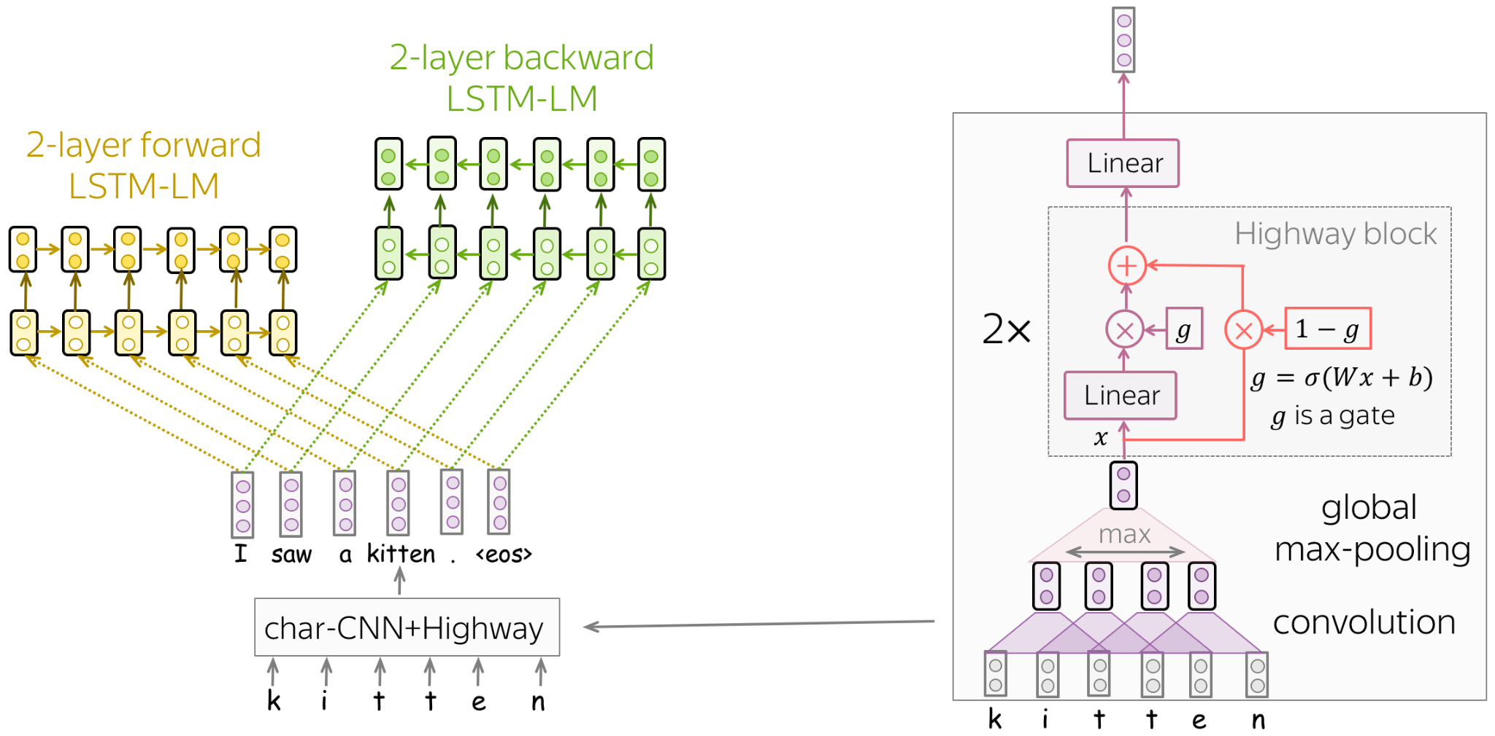
ELMo
Notes:
two-layer LSTM language models: forward and backward. => each token could have both contexts: left and right
in the standard word embedding layer, for each word in the vocabulary we train a unique vector. In this case,
word embeddings do not know the characters they consist of (e.g., they don't know that the words represent, represents, represented, and representation are close in writing)
we can not represent out-of-vocabulary (OOV) words.
To address these problems, the authors represent words as outputs of a character-level network.In this way, word representations know their characters by construction, and we can represent even those words we've never seen in training.

Slide 67
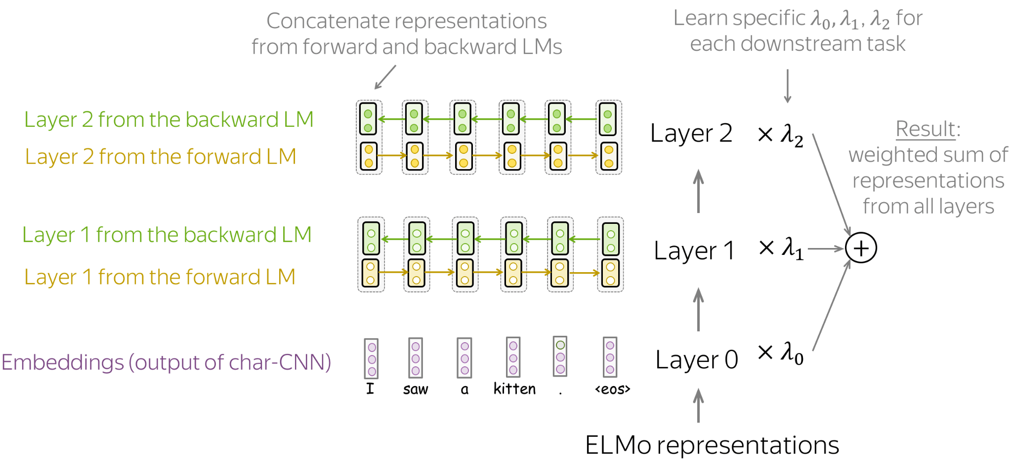

ELMo
Concatenating forward and backward vectors => "knows" both left and right contexts.
task-specific weights to combine representations from the layers.

Slide 68

Idea 2: No more task-specific models
Cove/ELMo replace word embeddings, but GPT/BERT replace entire models.
Notes:
Before: Specific model architecture for each downstream task
Note that ELMo/CoVe representations were mainly used to replace the embedding layer, and kept task-specific model architectures almost intact.
After: Single model which can be fine-tuned for all tasks
GPT/BERT act not as a replacement for word embeddings, but as a replacement for task-specific models. In this new setting, a model is first pretrained using a huge amount of unlabeled data (plain texts). Then, this model is fine-tuned on each of the downstream tasks. What is important, now during fine-tuning you have to only use task-aware input transformations (i.e. feed the data in a certain way) instead of modifying model architecture.

Slide 69



GPT
GPT: Generative Pre-Training for Language Understanding
a Transformer-based left-to-right language model. The architecture is a 12-layer Transformer decoder (without decoder-encoder attention).
Pre-training:
at the timestep t the model predicts a probability distribution
The model is trained with the standard cross-entropy loss, and the loss for the whole sequence is

Slide 70


GPT
Fine-tuning: In the fine-tuning stage, the model architecture stays the same except for the final linear layer. What changes is the input format for each task
The fine-tuning loss consists of the task-specific loss, as well as the language modeling loss:

Slide 71
GPT
GPT versions:
GPT-1: Improving Language Understanding by Generative Pre-Training
GPT-2: Language Models are Unsupervised Multitask Learners
GPT-3: Language Models are Few-Shot Learners
These models are different mostly in the amount of training data and the number of parameters. Note that these models are so big, that only huge companies can afford to train one. This gave rise to lots of discussions of concerns related to the use of such huge models (ethical, environmental, etc.)
GPT-3 can take millions of dollars to train !
A cool demo of GPT: https://app.inferkit.com/demo

Slide 72

BERT
BERT: Pre-training of Deep Bidirectional Transformers for Language Understanding
(Best Paper Award at NAACL 2019)
Notes:
BERT's model architecture is very simple and you already know how it works: it's just the Transformer's encoder. What is new, is the training objectives and the way BERT is used for downstream tasks.

Slide 73

BERT
Training Input: Pairs of Sentences with Special Tokens
Notes:
In training, BERT sees pairs of sentences separated with a special token-separator [SEP]. To let the model easily distinguish between these sentences, in addition to token and positional embeddings it uses segment embeddings.
Another special token is [CLS]. In training, it is used for the NSP objective we'll see next. Once a model is trained, it is used for downstream tasks.

Slide 74
BERT
Pre-Training Objectives: Next Sentence Prediction (NSP)
Input: [CLS] the man went to [MASK] store [SEP] he bought a gallon [MASK] milk [SEP]
Label: isNext
Input: [CLS] the man went to [MASK] store [SEP] penguin [MASK] are flight ##less birds [SEP]
Label: notNext

Slide 75

BERT
Pre-Training Objectives: Masked Language Modeling (MLM)
Notes:
BERT has two training objectives, and the most important of them is the Masked Language Modeling (MLM) objective. is With the MLM objective, at step the following happens:
select some tokens (each token is selected with the probability of 15%)
replace these selected tokens (with the special token [MASK] - with p=80%, with a random token - with p=10%, with the original token (remain unchanged) - with p=10%)
predict original tokens (compute loss).

Slide 76

BERT
Pre-Training Objectives: Masked Language Modeling (MLM)
MLM is still language modeling: the goal is to predict some tokens in a sentence/text based on some part of this text.
Notes:
At each step, the standard left-to-right LMs predict the next token based on the previous ones. This means that final representations, the ones from the final layer that are used for prediction, encode only previous context, i.e. they do not see the future.
Differently, MLMs see the whole text at once, but some tokens are corrupted: that's why BERT is bidirectional. Note that to let ELMo know both left and right contexts, the authors had to train two different unidirectional LMs and then concatenate representations of both of them. In BERT, we don't need to do that: one model is enough.

Slide 77


BERT
Fine-tuning: Single sentence classification
Input only 1 sentence
predict the label from the final representation of the [CLS] token.
Demo from Doccano

Slide 78


BERT
Fine-tuning: Sentence Pair Classification
feed the data as you did in training
predict the label from the final representation of the [CLS] token.

Slide 79


BERT
Fine-tuning: Question Answering (span extraction)
feed a question and a passage
for each token in the passage, predict whether this token is the start or the end of the correct segment.

Slide 80


BERT
Fine-tuning: Single sentence tagging
feed one sentence
predict tags for each token.
Demo from Doccano

Slide 81
Summary
Embedding method | Sparse/Dense | What information is embedded ? | How to compute ? | Context sensitive
One-hot | Sparse | Presence | No need to be trained | No
Word2vec, GloVe | Dense | Meaning | Trained using shallow nets | No
CoVe, ELMo, BERT | Dense | Meaning | Trained using deep nets | Yes

Slide 82
Summary
Language Model | Mechanism | Representation | Complexity | Should you use it ?
N-grams | Statistical | Occurrence | Light-weight, no pre-training needed | Maybe
RNN, CNN based | Neural Nets | Meaning | Medium-sized, pre-training needed | Maybe
GPT, BERT (transformer-based) | Neural Nets with attentions | Meaning | Can be very big, pre-training needed | Maybe

Slide 83
References
A powerful library to work with transformers: huggingface.co/transformers/
A cool course where I take the materials from: lena-voita.github.io/nlp_course.html
An awesome course from Stanford taught by Prof. Christopher D. Manning: https://web.stanford.edu/class/cs224n/

